Slide 1
Travelling Salesman Problem
by Hung Nguyen

Slide 2
Problem statement
“Given a list of cities and the distances between each pair of cities, find the shortest possible route that visits each city and returns to the origin city”
Graph problem
Find the shortest path that visits all the nodes and come back to the origin node.

Slide 3
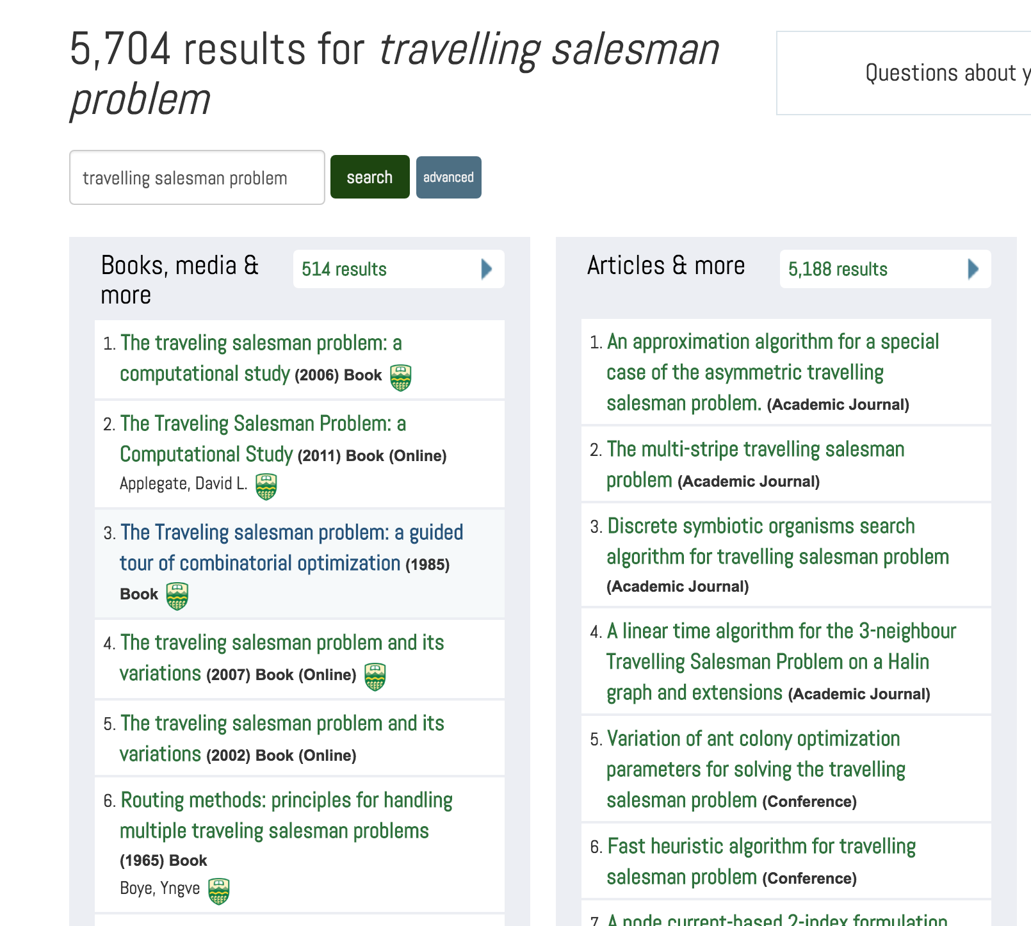
Applications
Vehicle routing
UPS delivery
School bus routing
Let’s go micro…
Computing Wiring
PCB production

Slide 4
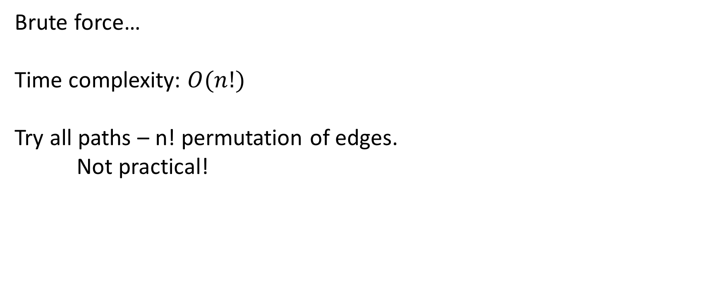
Exact algorithm
Brute force…
Time complexity: $O(n!)$
Try all paths – n! permutation of edges.
Not practical!

Slide 5
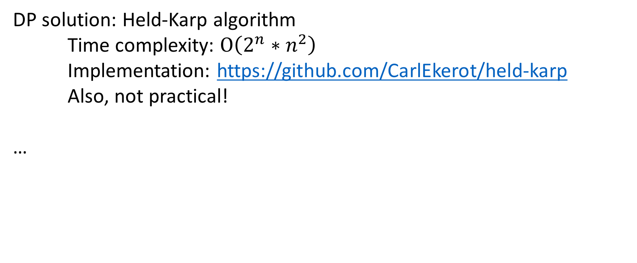
Exact algorithm (cont.)
DP solution: Held-Karp algorithm
Time complexity: $O\left(2^{n}∗n^{2}\right)$
Implementation: https://github.com/CarlEkerot/held-karp
Also, not practical!
…

Slide 6
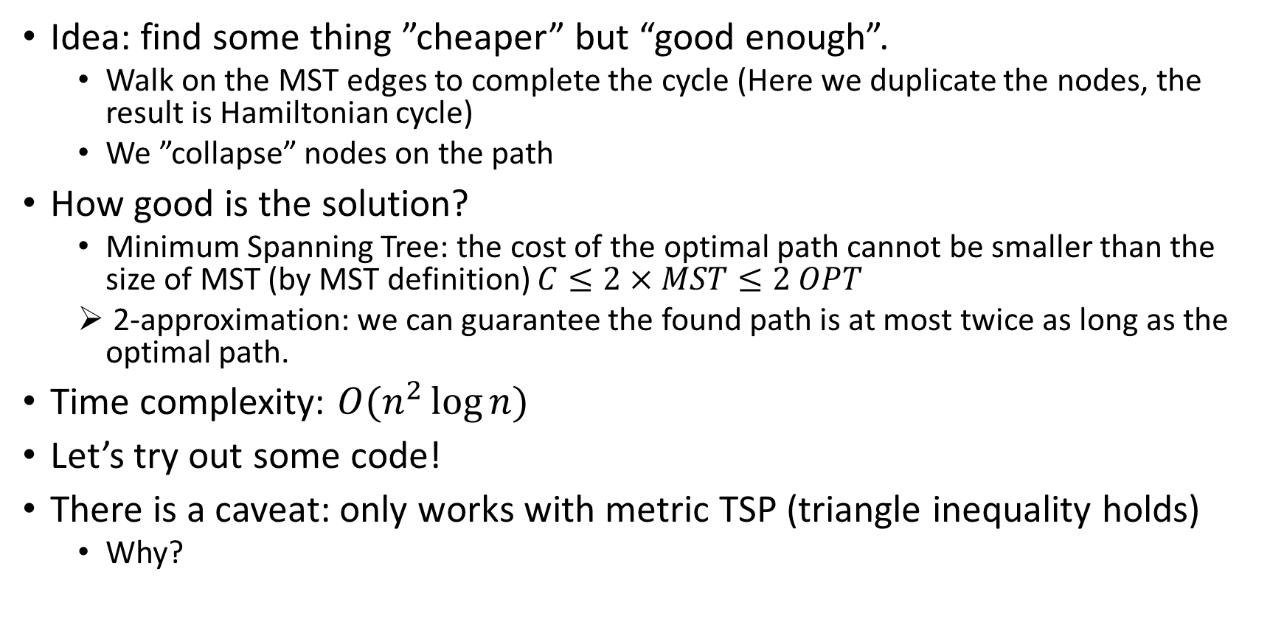
Heuristic – Approximation
Idea: find some thing ”cheaper” but “good enough”.
Walk on the MST edges to complete the cycle (Here we duplicate the nodes, the result is Hamiltonian cycle)
We ”collapse” nodes on the path
How good is the solution?
Minimum Spanning Tree: the cost of the optimal path cannot be smaller than the size of MST (by MST definition) $C≤2 × MST≤2 OPT$
2-approximation: we can guarantee the found path is at most twice as long as the optimal path.
Time complexity: $O(n^{2}\log{n})$
Let’s try out some code!
There is a caveat: only works with metric TSP (triangle inequality holds)
Why?

Slide 7
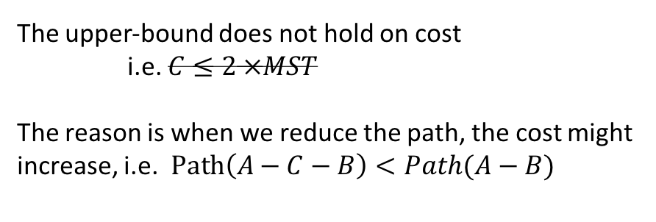
Triangle inequality
White board….
The upper-bound does not hold on cost
i.e. $C≤2 ×MST$
The reason is when we reduce the path, the cost might increase, i.e. $Path\left(A−C−B\right)<Path(A−B)$

Slide 8
Sources
MST: Code Archieve
Fleury: https://www.geeksforgeeks.org/fleurys-algorithm-for-printing-eulerian-path/
Held-karp: https://github.com/CarlEkerot/held-karp
This presentation: https://github.com/Hank-TNguyen/CMPUT-403-demo

Slide 9
Thx!

Slide 10
UVa problem
https://uva.onlinejudge.org/index.php?option=com_onlinejudge&Itemid=8&page=show_problem&problem=52
UVa_116 – Unidirectional TSP

